Slide 1
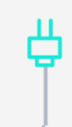


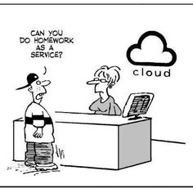
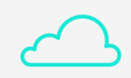





Option #1
What’s That Cloud?
With Jasleen Sondhi

Slide 2
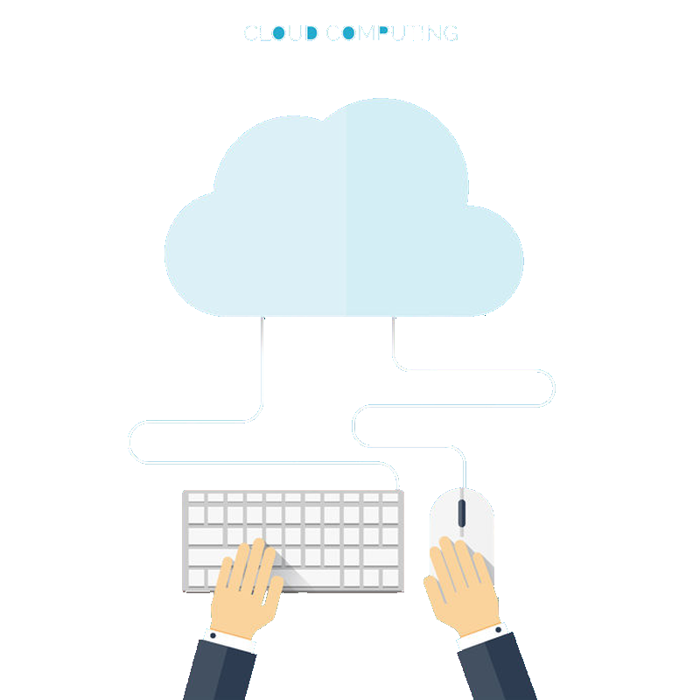

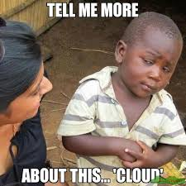
What is Cloud?
Cloud computing allows businesses to run essential programs and applications through the Internet, saving them time, space, hassle and lots and lots of money.
Billing for cloud services works just like the way you pay for utilities like gas and electricity in your home; it's pay-as-you-go.

Slide 3
What is Cloud?
Let’s watch a quick video before we get started!

Slide 4
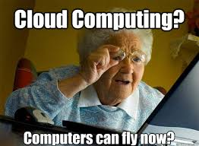
Benefits of Cloud Computing
Its cost-effective(Consumption Based Model)
It's scalable
It’s elastic
It's current
It’s reliable and secure
It’s global

Slide 5
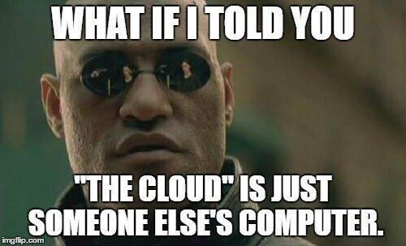
3 Cornerstones of Cloud
Software as a Service-Software as a service, is a way of delivering centrally hosted applications over the internet as a service.
Infrastructure as a Service-Infrastructure as a service, IaaS or IaaS, allows customers to instantly build out new hardware and other network devices.
Platform as a Service-Platform as a Service or PaaS is relatively new to the cloud world but it has quickly gained customers as it provides an easier approach to accessing a development rich environment for application building.

Slide 6
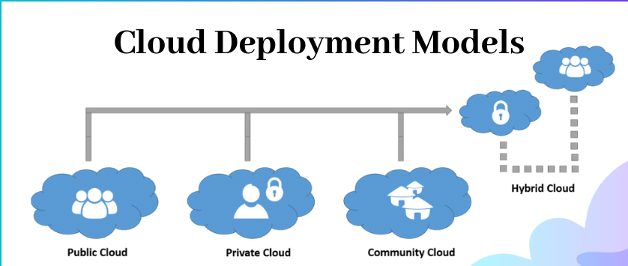

Slide 7
Cloud Deployment Models
A cloud deployment model basically defines how the data is stored and how users interact with it.
There are primarily 4 types of models-
Public-Public Cloud is a type of cloud hosting that allows the accessibility of systems & its services to its clients/users easily.
Private-As opposed to a public cloud that is available to the general public, only one specific company owns a private one.

Slide 8
Cloud Deployment Models
Community-A community deployment model largely resembles a private one; the only difference is the set of users.
Hybrid-Hybrid Cloud is another cloud computing type, which is integrated, i.e., it can be a combination of two or more cloud servers, i.e., private, public or community combined as one architecture, but remain individual entities.

Slide 9
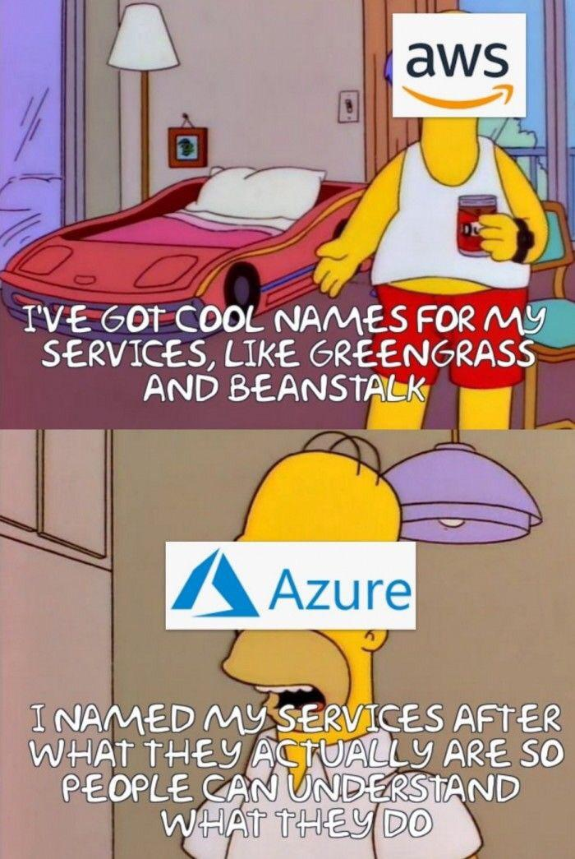
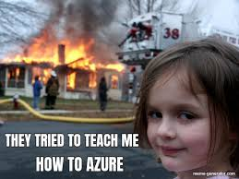
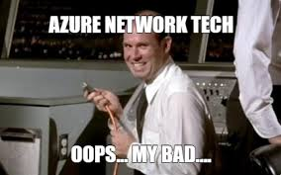
What is Microsoft Azure?

Slide 10
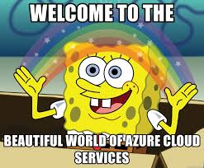
Microsoft Azure
The Microsoft Cloud is very, very large. It is connected by enough fiber to stretch to the Moon and back 3 times! That means the Microsoft Cloud is made up of millions of servers and everything is monitored 24x7x365.
Did you know that more than 90% of Fortune 500 companies run on the Microsoft Cloud?
Azure is Microsoft’s very own cloud computing platform. It offers the freedom to build, manage, and deploy applications on a massive, global network using your favorite tools and frameworks.

Slide 11
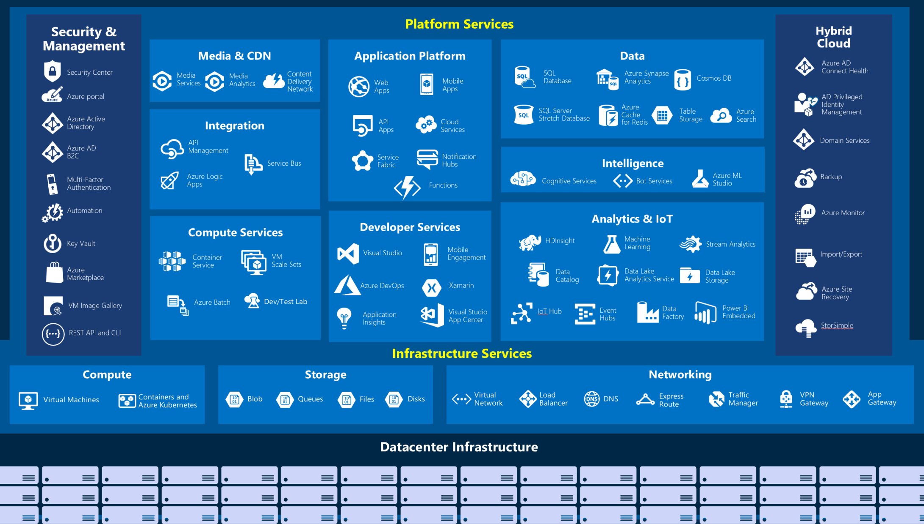
Tour of Azure Services

Slide 12
Lets do a quick tour of Azure and create something!

Slide 13

Thank you!

